Slide 1
Smashing the (64-bit) Stack
SecureSet March 2018

Slide 2
ssh
10.0.16.14

Slide 3
Basic memory corruption exploitation
Stack focused buffer overflows are some of the oldest memory corruption exploits
Lots of examples and walk-throughs on doing a variety of 32-bit buffer overflow stack smashing but fewer on 64-bit … and there are some slight differences
But we’re also interested at gaining some ‘hands on the keyboard’ time with the Linux command line, GDB, and Metasploit’s shellcode generating capabilities

Slide 4
Historic View
Read this classic paper on buffer overflows by Aleph One. His paper on “Smashing the Stack for Fun and Profit” can be found at http://phrack.org/issues/49/14.html
I also recommend checking our Sam Bowne’s recently posted videos on shellcode and exploits. The specific video on creating 32-bit Linux buffer overflow exploits can be found at https://www.youtube.com/watch?v=FIvBAkDzf30

Slide 5
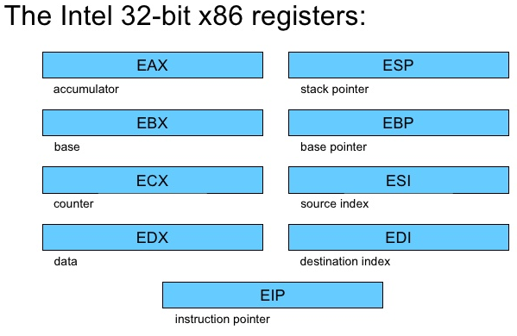
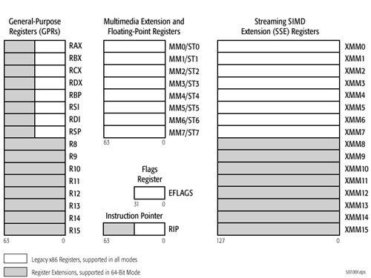
Living at Machine Code Level

Slide 6
Stage 1: Compile source code for the vulnerable program
Our sample vulnerable program is a very simple C language program consisting of a 256-byte character array to serve as the variable we will overflow, a couple of printf() statements and the especially problematic strcpy() function call. Compilers will warn you when you use functions such as strcpy() because these functions do not perform any bounds checking when they copy one variable into another. The C programming language places almost all responsibilities on the programmer and the user to make sure any rules are not broken and that all inputs are only as they should be; C is a step above assembly language which has pros but possibly more cons by today’s standards. It results in fast executing code but speed is not as important a factor today as it had been in the 1970s and 80s. Modern languages execute slower than an equivalent in C but these languages bring greater abstraction, error checking, type safety, and memory protections.

Slide 7
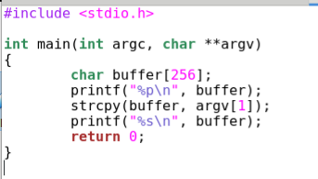
C Source Code

Slide 8
curl https://raw.githubusercontent.com/patrick-usf/CIS3367/master/mybuffer.c > mybuffer.c

Slide 9
Compile Options
With the source code on your CentOS virtual machine, compile the source into an executable program with gcc and be sure to use these additional flags. What are these options?
‘-g’ flag will make it possible for us to refer back to the C source code from within GDB
‘-z execstack’ will override a security feature built into compilers to help prevent stack buffer overflow exploits by marking the memory pages used by the stack and the heap as being READ ONLY; since we will want to execute code directly from the stack we need to make sure the memory pages are marked READ & EXECUTE
‘-fno-stack-protector’ overrides yet another security feature built into compilers to help prevent stack overflow exploitation by including ‘stack canaries’ (also called ‘stack cookies’) that the system will confirm are still intact as it unwinds the stack as function calls return. If the canary value is not as expected then an exception is raised and the exploit shellcode does not have the chance to execute. There are exploitation techniques to overcome this security feature but we could do an entire semester on exploitation techniques, countermeasures, and exploit countermeasures to the defensive countermeasures.

Slide 10
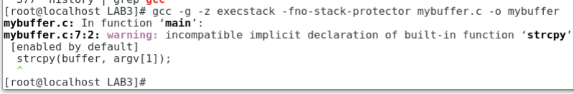

Slide 11
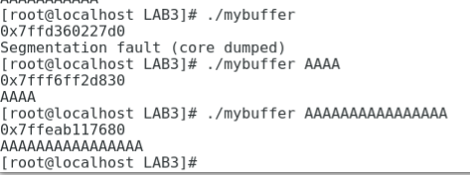

Slide 12

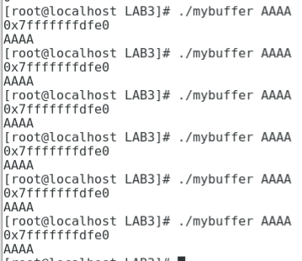
Disable ASLR and Retry

Slide 13
Stage 2: Find the point where we can induce an overflow and crash
From the source code we know that we defined our buffer with 256 bytes so we could reasonably expect the buffer to overflow at some value above 256. But what if you don’t have the source code for a program? You can feed it increasing inputs until it faults. Or you could use a ‘fuzzer’, a program designed to create a series of ‘guided-random’ inputs to a program. But we won’t be fuzzing this program as that would be overkill for this simple and highly vulnerable program. Instead we can use a simple python command to generate inputs of increasing length and see what it takes to generate a segment fault:

Slide 14
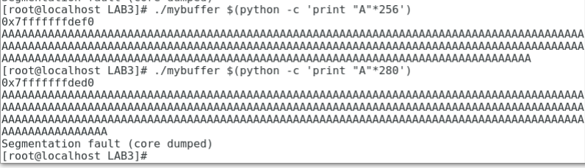
Commandline Scripting

Slide 15
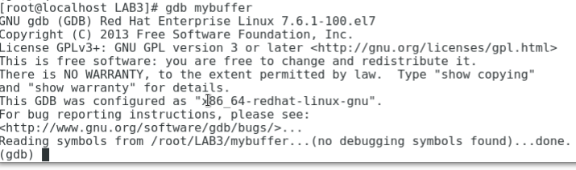
Linux debugger: gdb

Slide 16
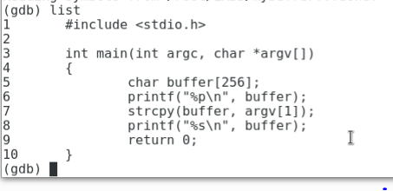
‘list’ command

Slide 17
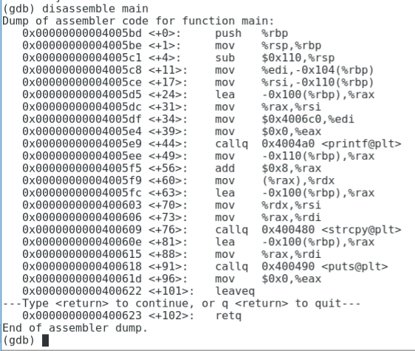
‘disassemble’

Slide 18
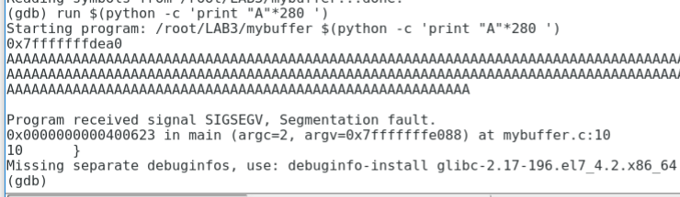
‘run’ and pass arguments

Slide 19
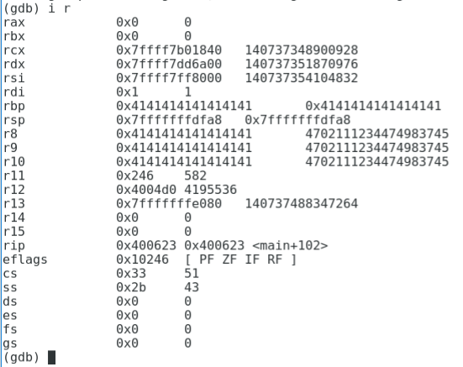
BOOM! … or let’s look at registers

Slide 20
What am I looking at ??
We can see that the “A” characters (ASCII hex value ‘41’) has filled many of the registers as the stack attempted to unwind, filling RBP, R8, R9, and R10. What we want is control of the Instruction Pointer (RIP) which currently has the value 0x400623 and GDB informs us that this refers to <main+102>, which if we look back at our disassembled machine code we see that line 102 is the end of the program.

Slide 21
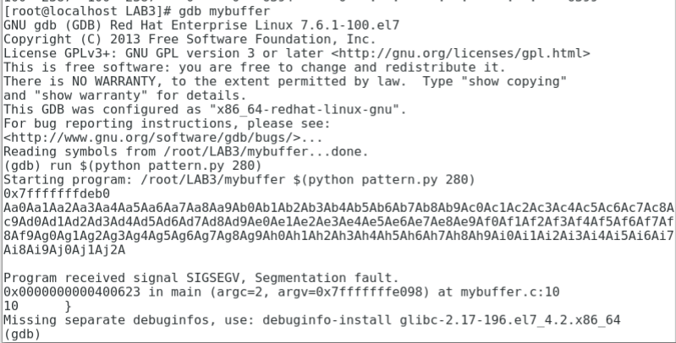
Cute but so what? A bunch of ‘A’s?

Slide 22
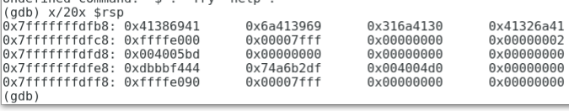
Round 2: Using a pattern
Our buffer overflow did not insert a series of ‘41’ values into RIP, though. What happened?
The RSP register is pointing to the memory address 0x7fffffffdfb8 so let’s take a look at what is in that memory address by using the ‘x’ GDB command:

Slide 23
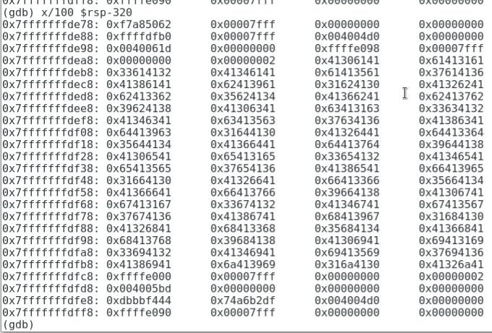
Let’s look at more memory

Slide 24
The Magical RSP Register
But back to the value in RSP we can see that the value at RSP is not the end of our buffer:
The hex value at RSP, 0x41386941 (in little Endian format!!), is where we will want to insert our desire RIP address but there is further pattern after this value. Our Python pattern.py script can look up the offset for this value but since we’re working with a minimal distro the Python script’s ability to convert back and forth from hex is not working so we will use GDB to display for us the 6 ASCII characters starting at the address for RSP:

Slide 25
Little Endian to Humanian
Our Python pattern.py script can look up the offset for this value but since we’re working with a minimal distro the Python script’s ability to convert back and forth from hex is not working so we will use GDB to display for us the 6 ASCII characters starting at the address for RSP:
This has displayed the decimal values for the hex and then the ASCII character. So our six ASCII characters starting at the address held in RSP are: “Ai8Ai9”

Slide 26
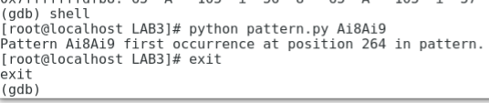
Drop to gdb shell

Slide 27
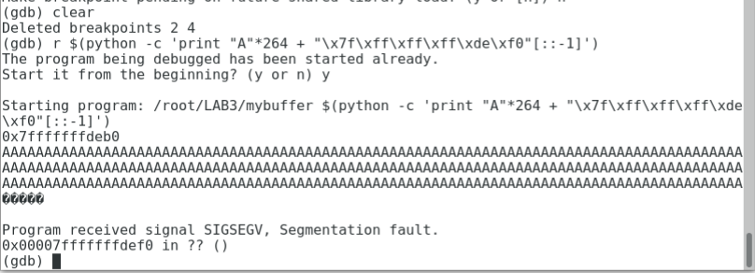
Stage 3: Demonstrate control of RIP
We now believe that we can insert 264 bytes of buffer and then we should be able to insert an address of our choice that will get loaded into RIP. Let’s give this a try …. And we will pick 0x7fffffffdef0 which is inside the buffer we control (first I will also ‘clear’ the existing breakpoints in GDB).

Slide 28
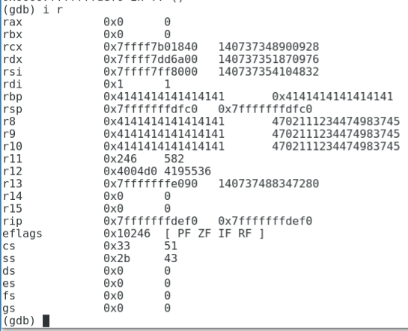
Look at Registers in GDB
Interesting! We have a segmentation fault and what is the RIP reported? The one we loaded onto the tail end of our buffer. If we do a manual inspection of the CPU registers:

Slide 29
Stage 4: Find and Insert shellcode of our choice
You can write your own shellcode in C or assembly, compile the code, and extract the necessary instructions and leave behind the unneeded machine code. Or you can use shellcode from a (hopefully) trusted source … either way it is a good idea to verify what the shellcode actually does before using it but that is beyond our scope of today.
For this lab I have made available shellcode that will display the contents of the /etc/shadow file. Reading this file requires root level privilege and we are running this vulnerable program as root (!) so it should be able to read the file and display the contents back to us. The shellcode to perform this task is 82 bytes in length:

Slide 30

Cat /etc/shadow payload

Slide 31
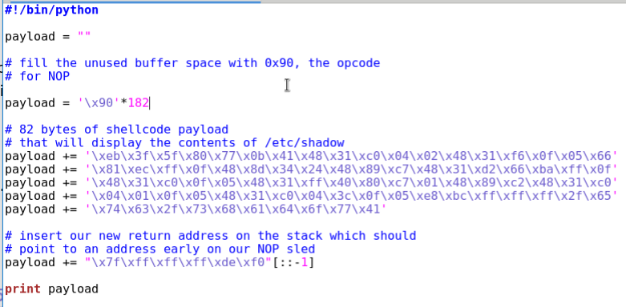
Put it all in a single python file

Slide 32
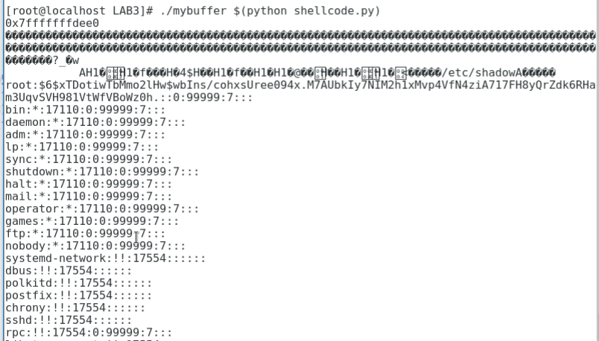
Try it out on the commandline

